Slide 1
Ulaştırma ve Altyapı Bakanlığı
DHMİ Genel Müdürlüğü
Havalimanları Slot Koordinasyon Merkezi (HSKM) Başmüdürlüğü

Slide 2

GCR
(GENERAL AVIATION SLOT CLEARANCE REQUEST)

Slide 3
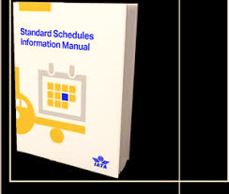

*the slot clearance process for General Aviation (GA) & Business Aviation (BA) operations
Information in this Guide is extracted from Appendix K of the IATA SSIM (Standard Schedules Information Manual) IATA General (Aviation) Clearance Request (GCR) format.

Slide 4


GCR Message Principles
• only uses ICAO codes for aircraft and airports.
• reference ----REG or FLT
• For GCR communication using E-mail the GCR message should be in plain text placed directly in the E-mail body. No attachments or special characters should be used.
• in UTC
• in single day format only
• does not contain a frequency rate (day of week) indicator.

Slide 5

Following flights are exempted from slot coordination procedure:
✓ Government flights (service type E)
✓ Ambulance flights (service type I)
✓ State flights (service type I)
✓ Military flights (service type W)
✓ Search and Rescue flights
✓ Flights for Humanitarian reasons
The following Service Types will be used for requests concerning General/Business aviation.
✓ Private/General Aviation (D)
✓ Business/Corporate Aviation / Air Taxi (N)
✓ Positioning /ferry (P)
✓ Technical stop (X)

Slide 6
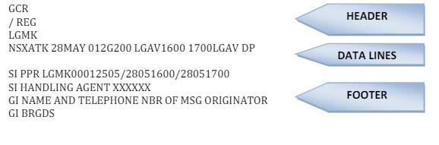
Requesting a GA/BA slot
The GCR message must be composed of 3 parts:
1. HEADER
2. DATA LINE(S)
3. FOOTER

Slide 7
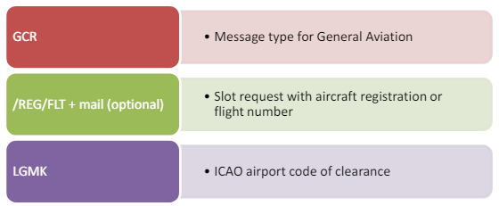
1. HEADER

Slide 8

2. DATA LINE(S)
NVHLEE 31JUL 018CRJ2 YPDN1920 D
3. FOOTER
Any non-standard format text must be put in the footer preceded by a “SI” or “GI”.
SI - stands for special information at end of message.
GI - stands for general information at end of message.

Slide 9
The GCR message uses the following action codes:
Operator
C - Schedule to be changed
D - Delete schedule
N - New schedule
R - Revised schedule
Coordinator
H – Holding
K – Confirmation
U - Refusal
W - Unable to reconcile flight information
X - Cancellation
Note: Unlike SCR, there is no action code “O” (Offer) in GCR. The nearest available slot will be confirmed by coordinator using the action code “K”.

Slide 10
GIR
(General Aviation Information Request/Reply) Message
The GIR request for a time period is limited to one day only, a range of dates is not permitted.
GIRs include only the GA/BA flights held with aircraft registration (REG) and are shown with a generic two letter code GN.

Slide 11

GIR
/FLT
LPPT
QGN1215 GN1215 07MAY
SI
GIR
/FLT
LPPT
HGN1215 GN1215 07MAY 012CL60 GLRB0130 0230EGGW DD/ RE.GLWDC/
************************************************************************
GIR
/REG
LPPT
QGLWDC 07MAY
SI
GIR
/FLT
LPPT
HGLWDC 07MAY 012CL60 GLRB0130 0230EGGW DD

Slide 12

Note:
The Generic Code for carrier code is- GN
The Generic Code for General aviation aircraft is- GAA
The Generic Code for Airports is- XUD

Slide 13


Message type for operation under registration and domestic flight to two level 3 airports;
GCR
/REG
EDDF
N HBIEV 08JUN 010G159 0900EDDM D
EDDM
NHBIEV 08JUN 010G159 EDDF 1000 D
SI
GCR
/FLT
EDDF
N ABC123 08JUN 010G159 0900EDDM D
EDDM
NABC 08JUN 010G159 EDDF1000 D
SI

Slide 14


Message Use/ Flows
GCR
/REG
LTAI
NXYZAT 02MAY 018GLF5 OOMS1110 1145LIMG NN
SI
GI
GCR
/REG
LTAI
KXYZAT 02MAY 018GLF5 OOMS1110 1145LIMG NN / IDA.LTAIAGN0015000 IDD.LTAIDGN0016000 TA.T2 TD.T2/
SI
GI

Slide 15

GCR
/REG
LTAI
NTCABC 25APR 014GRJ LMML1400 D / RE.XYZTC /
SI
Line number: 4
A new and different aircraft registration defined via tags
GI BRGDS
GCR
/FLT
LTBJ
KXYZ005 XYZ005 26APR 022A20N LTFE0900 1000LTFE DD / IDA.LTBJAXYZ000500 IDD.LTBJDXYZ000500 RE.SDFGH TA.D TD.D/
SI
SI UCAK TIPININ ICAO KODU SSIM DA BELIRTILMEDIGINDEN EN YAKIN
SI UCAK TIPI SECILMISTIR. UCAK TIPI HAWKER C90 DIR.

Slide 16

GCR
/REG
LTBJ
N TCABC-1 07MAY 009CL35 1200LTBA N
NTCABC-1 07MAY 009CL35 LTBA1355 P
GI
GCR
/REG
LTBA
CXYZTM 15MAY 010CL30 LIPZ1325 15002LKPR DD
RPLM001 PLM002 15MAY 010CL30 LIPX1320 10301LTFM NN
SI
GI
** could not be handled
GIR
/FLT
LTBJ
QABC005 ABC005 28APR10MAY 0000507
*GIR requests are limited one day only

Slide 17

Note: Changes of registration in the same GCR message will not be accepted.
When a change of aircraft registration is required for a GA/BA flight with already confirmed slots, even when all other SSIM line data remain the same, the aircraft operator and/or handler should DELETE the already confirmed slots in one GCR and a new GCR request for NEW slots should follow with the new a/c registration

Slide 18

Teşekkür Ederim

Slide 19
DHMİ GENEL MÜDÜRLÜĞÜ HAVALİMANLARI SLOT KOORDİNASYON MERKEZİ (HSKM) BAŞMÜDÜRLÜĞÜ
ADRES: İstanbul Havalimanı İmrahor Mah.
Vecihi Hurkus Cad. No: 6 Kat:2 (VIP Yanı) 34275
Arnavutköy-ISTANBUL
TEL: 0 212 891 74 00
FAX: 0 212 891 7404
SMA-SCR mesajları için : tr.slot@dhmi.gov.tr
E-MAIL: dhmi.slot@dhmi.gov.tr

Slide 20
SLOT KOORDİNASYON ŞUBE MÜDÜRLÜĞÜ
TEL:
SKM Dönemsel Planlama: 0 212 891 74 55
SKM Monitoring Ünitesi: 0 212 891 74 75
SKM Operasyon: 0 212 891 74 85
E-MAIL:
SKM Dönemsel Planlama: dhmi.sccplanning@dhmi.gov.tr
SKM Monitoring Ünitesi: dhmi.sccmonitoring@dhmi.gov.tr
SKM Operasyon: dhmi.sccoperation@dhmi.gov.tr
FAX: 0 212 891 74 74
SMA-SCR mesajları için : tr.slot@dhmi.gov.tr

